Slide 1
UNV Intelligent Portable Measuring Instrument
Notes:
逻辑：从外到内再到应用。

Slide 2
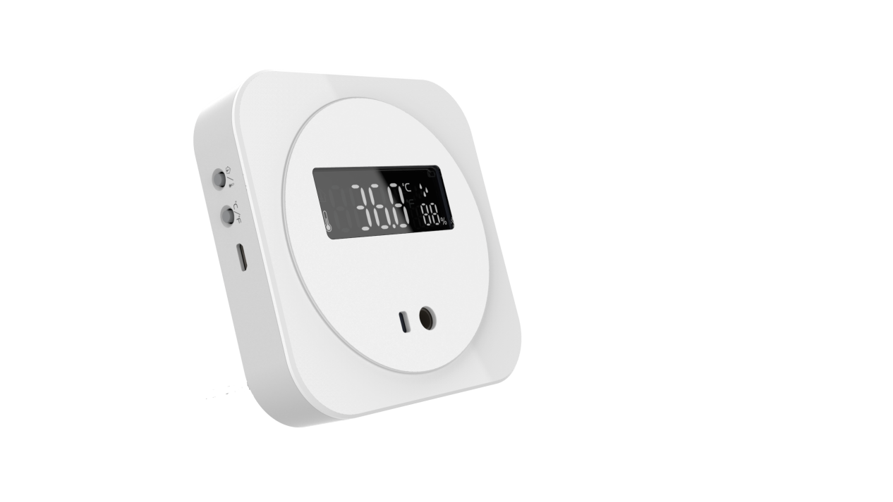
UNV Intelligent Portable Measuring Instrument
Make fever detection simple
0.1℃ accuracy, 0.2℃ deviation
Plug & Play, Non-contact wrist screening
Body + Ambient temperature measurement
Delicate hardware design

Slide 3
Product overview
Delicate Design
Accurate
Multiple Use

Slide 4
Delicate appearance, suitable for everywhere
Mode switch button
Negative LCD screen
5
1
Micro-USB power supply interface
Ambient temperature/humidity sensor
6
2
ABS shell
TOF (time of flight) sensor
3
7
Thermopile sensor
4

Slide 5
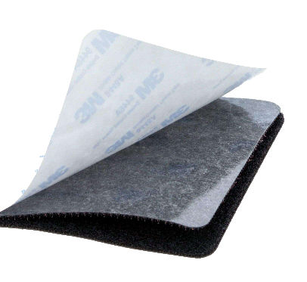
Flexible Installation
Contains double-sided tape, wall mount
Desktop bracket mount
Notes:
自带双面胶，可进行壁装。
适用墙面：普通墙面（公司这种），瓷砖、金属
不适用：粗糙墙面、掉灰墙面、网孔表面；
还可以购买搭配的支架，安装上，就可以放置在桌面了。

Slide 6
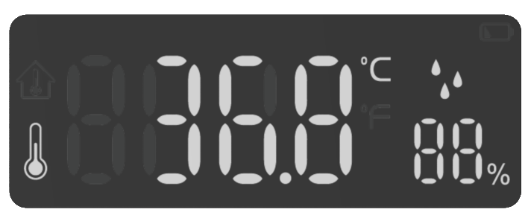
Negative LCD Screen
Negative LCD screen
Backlight, using in low light
Provide clear view even under sunlight
Positive LCD screen
Limited brightness
Notes:
更大的数字，温度信息一目了然。
负显液晶屏，也就是黑底白字，具有更高的亮度和对比度，在强光下也清晰可见。由于有背光加持，环境光暗的场景也适用。
和正显液晶屏的对比，可以看到更清晰，对比度更高。

Slide 7
Smaller Size, Smaller Deviation
1. ToF(time of flight) sensor measures distance,
and tells when to detect
2. Thermopile sensor detect heat
temperature
heat
distance
3. Transfer from heat to body temperature, final deviation : ±0.2℃
Notes:
测体温时，测温盒的实现方式。按传感器的工作流程，有三步。
第一步，距离传感器，探测距离。5CM。
第二步，热电堆传感器探测到热量。
第三步，在内部，热量形成热电势，再汇聚成热电偶，形成电压，被探测到，然后转换为体温。

Slide 8
How to Realize Small Deviation
Internal design
Application conditions
Thermopile
sensor isolation
hardware design
Indoor temperature 16℃~35℃
Target temperature 35℃~42℃
Prevent the heat of main control PCB from affecting the thermopile sensor
The deviation of body temperature
measurement is ±0.2℃
Notes:
内部：热电堆传感器硬件独立设计，设计了独立的空间，能够防止主控电路板散热对热量探测的影响。
外部：要求环境温度为16-35，目标温度为35-42度，覆盖人体温度范围。测温模块受环境影响在可控范围内。

Slide 9
Not only a fever detection device,
but also an ambient thermometer.
Auto mode：Show the ambient temperature by default, turn into body temperature automatically when it’s detected
Ambient humidity：always on
Celsius degree
Body temperature mode：Show dash by default, turn into body temperature automatically when it’s detected
One-press switch
Ambient Temperature Mode
：Only measure the ambient temperature, turn off the body temperature measuring function
One-press switch
Fahrenheit degree

Slide 10
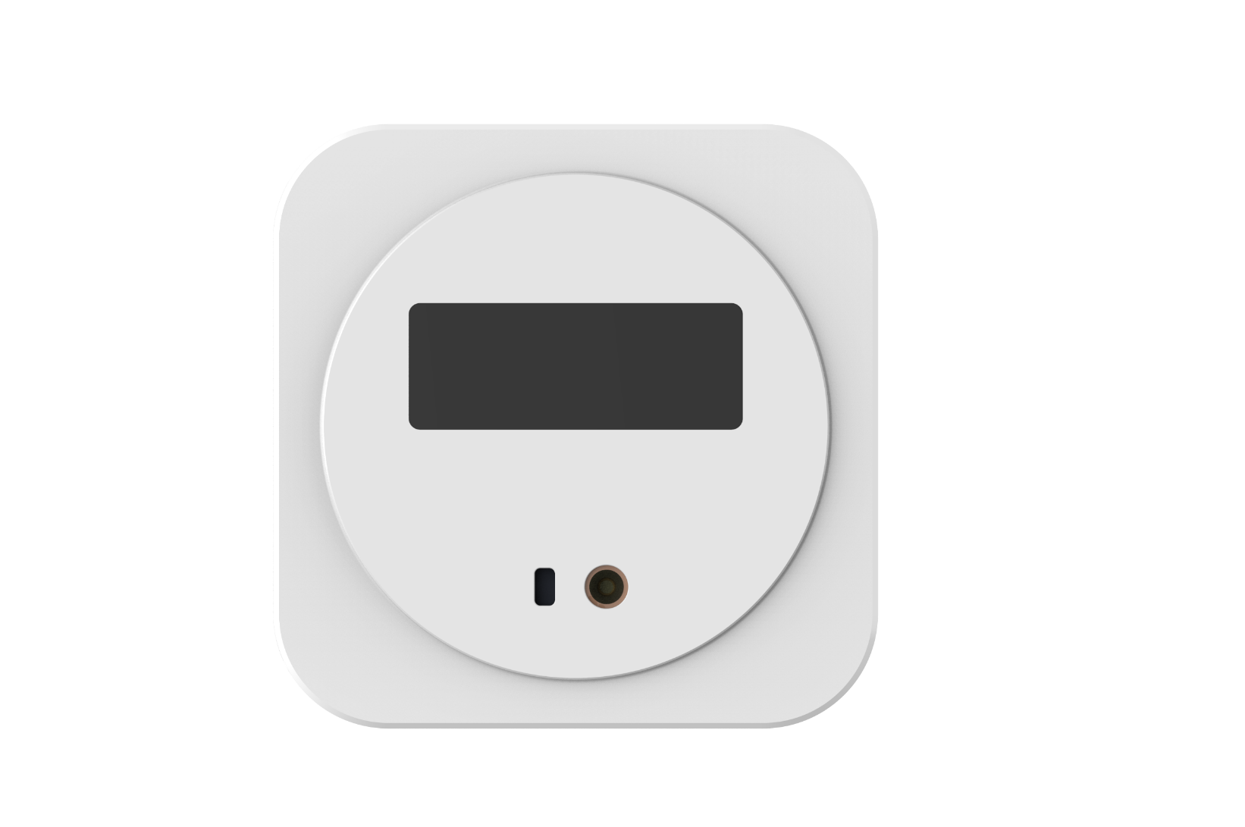
Plug & Play
Plug & play, starts to work once power on

Slide 11
Application
1 beep
3 beeps
Normal temperature
Abnormal temperature
Notes:
测腕温，右侧有蜂鸣器，测完滴一声，为正常体温。滴三声为异常。

Slide 12
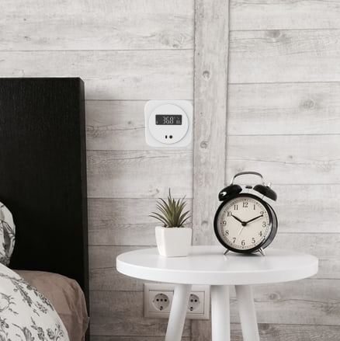
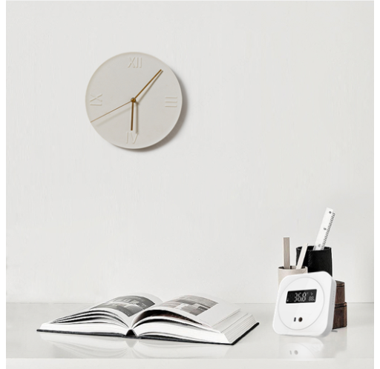
Application
Wall mount
Desktop mount

Slide 13
Application
Home
Office
Restaurant
Supermarket

